Slide 1

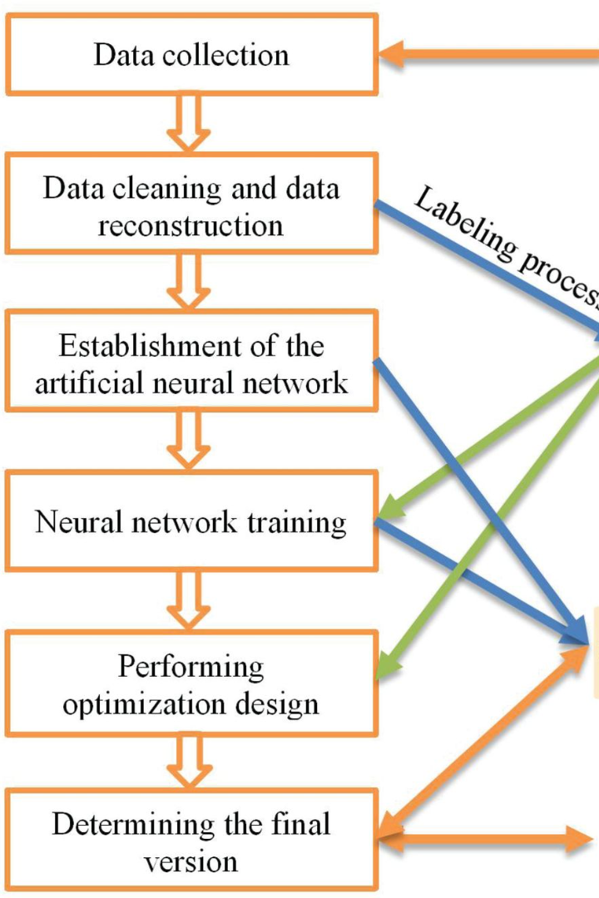
Introduction to Scalability Testing
Scalability testing is a critical aspect of software development, ensuring that a solution can handle increasing loads without compromising performance. It involves rigorous evaluation of the solution's performance under varying conditions to ensure optimal functionality and user experience.

Slide 2
Importance of Scalability Testing in Software Development
1
Enhanced User Experience
Scalability testing is crucial to ensure that software can handle increased loads without affecting user experience, leading to higher customer satisfaction.
2
Cost Savings
Identifying scalability issues early in the development process saves costs in the long run by preventing potential performance failures post-deployment.
3
Positive Brand Image
By delivering a scalable solution, a company can enhance its reputation in the market, attracting more users and gaining a competitive edge.

Slide 3
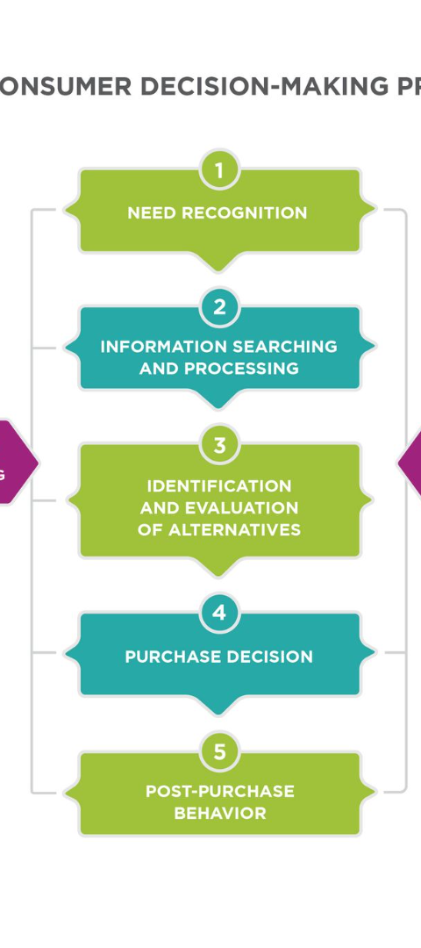
Overview of the Test Case: Rigorous Evaluation of the Solution's Performance
1
Comprehensive Analysis
The scalability test case involves a comprehensive analysis of the solution's performance under varying catalog sizes and user loads.
2
Realistic Scenarios
Real-world usage scenarios are simulated to ensure that the solution can handle peak loads effectively.
3
Performance Evaluation
It aims to evaluate the performance of the solution in terms of response time, throughput, and resource utilization.

Slide 4

Defining Varying Catalog Sizes for Testing
Small Catalog
Testing the solution's performance with a small catalog size to assess its functionality under minimal load.
Medium Catalog
Evaluating how the solution copes with a moderate catalog size, reflecting real-world usage scenarios.
Large Catalog
Assessing the solution's scalability under heavy loads with a large catalog, ensuring optimal performance in peak usage situations.

Slide 5
Methodology for Conducting the Scalability Test
Test Data Generation
Performance Monitoring
Load Balancing
Applying varying loads to the system to evaluate its ability to distribute and manage the load effectively.
Creation of realistic datasets to simulate different usage scenarios and catalog sizes.
Continuous monitoring of key performance metrics during the test to analyze the solution's behavior under varying loads.

Slide 6
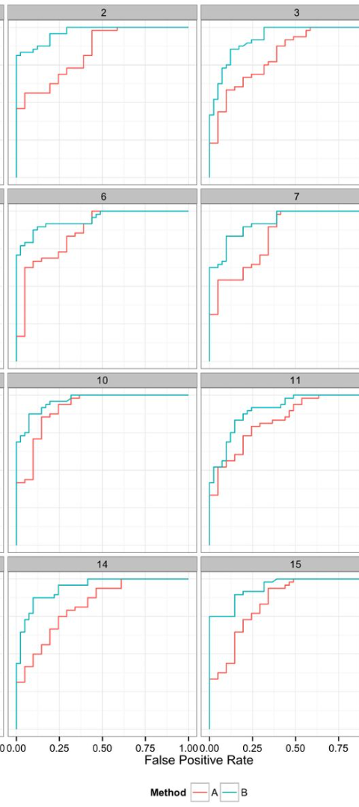
Metrics and Benchmarks Used to Measure Performance
1
Response Time
Measurement of the time taken by the solution to respond to a user's request under different loads and catalog sizes.
2
Throughput
Assessment of the number of transactions processed by the solution per unit of time, reflecting its processing capacity.
3
Resource Utilization
Analysis of the system's resource utilization, including CPU, memory, and storage, during peak loads.

Slide 7




Analysis of the Test Results and Identification of Bottlenecks
Data Analysis
Root Cause Identification
Improvement Prioritization
Thorough analysis of the test results to identify performance bottlenecks and areas requiring improvement.
Determination of the root causes of performance issues, including software limitations or infrastructure constraints.
Prioritization of improvement efforts based on the impact on scalability and criticality of the identified bottlenecks.

Slide 8
Recommendations for Optimizing the Solution's Scalability
1
2
3
Code Refactoring
Infrastructure Scaling
Caching Strategies
Optimizing the codebase to improve efficiency and resource utilization.
Investing in scalable infrastructure to accommodate increased loads and user growth.
Implementing effective caching mechanisms to reduce response times and enhance performance.

